Slide 1
The Hidden Cost of Firearm Violence on Infants in Utero
Janet Currie
Princeton University and NBER
Bahadir Dursun
Newcastle University and IZA
Michael Hatch
American University
Erdal Tekin
American University, IZA, and NBER

Slide 2
Motivation: A U.S. Epidemic of Gun Violence
>124 firearm-related deaths every day
In 2022, 47,785 people died of firearm violence, with over 20K homicides
Gun homicide rate is 25 times higher than other high-income countries.
400+ million guns in circulation
Direct costs include: Work loss, medical/mental health care, emergency transportation, police/criminal justice activities, insurance claims processing, employer costs and decreased quality of life, etc. and may exceed $557 billion annually (Everytown research)
There may be indirect costs on bystanders, including pregnant individuals and infants in utero.

Slide 3
Roadmap
Background
Data and Research design
2002 ”Beltway sniper attacks
Data on Mass Shootings
Overall estimates
Heterogeneous effects?
Behavioral effects?
Placebo analysis and robustness checks
Cost estimates
Conclusions

Slide 4
Background: We contribute to a small literature about the effects of gun violence on those who are not directly victimized
E.g. Rossin-Slater et al. (2020) find that local exposure to fatal school shootings results in persistent and significant increases in youth antidepressant use.
Bharadwaj et al. (2021) examine the aftermath of the 2011 mass shooting in Norway and find that surviving children had substantially lower grade point averages (GPAs), increased utilization of health care services, and more mental health diagnoses.
Gershenson and Tekin (2018) document that the beltway sniper attacks had a significant negative impact on academic achievement in Virginia's public elementary schools.
Ang (2021) demonstrates that exposure to police violence leads to persistent decreases in GPA, increased rates of emotional disturbance, and lower rates of high school completion and college enrollment.
We hypothesize that negative effects could start even earlier, in utero.

Slide 5
Background: The medical literature shows that stress during pregnancy can have negative effects on infant health
- Stress stimulates hormones that harm the fetus (corticotrophin-releasing hormone (CRH) and the hypothalamic-pituitary adrenal axis (HPA)) (Hobel and Culhane, 2003; Grote et al., 2010; Weinstock, 2008; Glover et al., 2010).
- Stress during pregnancy suppresses the mother’s immune system and harms the offspring’s immune system (Stott, 1973; Ruiz and Avant, 2005; Weinstock, 2008).
- Adverse behavioral responses to stress, e.g. maternal smoking or alcohol consumption, could harm fetal health.

Slide 6
Background: Stress during pregnancy can harm infant health
- Black et al. (2016), Persson and Rossin-Slater (2018a) examine stress in utero due to the death of close relatives, leveraging timing of death relative to the birth.
- Aizer et al. (2016) examine effect of maternal cortisol levels during pregnancy on children’s later test scores.
- Studies focus on events including earthquakes (Glynn et al., 2001; Torche, 2011), hurricanes (Currie and Rossin-Slater, 2013), domestic violence (Currie et al., 2022) the 9/11 terrorist attacks (Lauderdale, 2006; Brown, 2014), armed conflicts (Mansour and Rees, 2012), and landmines (Camacho, 2008). Some of the estimated effects could be due to direct victimization vs. stress.

Slide 7
Background: Health at Birth Predicts Outcomes
Low birthweight and prematurity lead to:
- higher risk of death and morbidity
- poorer cognitive development
- lower educational attainment
- lower future employment and earnings
(e.g., Black et al., 2007; Currie and Moretti, 2007; Oreopoulos et al., 2008; Currie et al., 2010; Figlio et al. 2014)

Slide 8
Background: Studies closest to ours are -
Torche and Villareal (2014). Monthly municipal-level Mexican data 2008-2010. In models with municipal FE, exposure to more homicides in the 1st trimester estimated to increase birthweight. Compensating behaviors? (e.g. increased prenatal care). Changes in population composition?
Goin et al. (2020) match CA neighborhoods with differing levels of firearm violence. Higher firearm violence increases risk of preterm delivery. Unobserved characteristics of neighborhoods may be associated both with more violence and poorer birth outcomes.

Slide 9
We rely on two complementary strategies to isolate the effects of exposure to firearm violence on infants in utero
1) Case study of the ”Beltway sniper”
attacks
October 2 – 24, 2002
13 victims (10 fatalities)
Intense media coverage
Affected behavior:
School closings
People avoiding public spaces
Zigzagging
Snipers captured on October 24th, 2002.

Slide 11
Notes:
Notes: This figure illustrates the precise locations of the Sniper Shootings that occurred between October 2 and October 22, 2002, as listed in Table 1. Red circles on the map denote a 10-mile radius around each incident, calculated based on the latitudes and longitudes of the shootings.

Slide 12
Second strategy is an analysis of counties with mass shootings
Our analysis of national data on mass shootings uses a measure the following definition:
The incident resulted in the death of four or more individuals, excluding the perpetrator(s);
Firearms were the primary weapons used in the incident; and
The incident is unrelated to gang, drug, or other criminal activity. The condition helps to identify incidents that a pregnant person might perceive as representing a threat to their own safety.
This definition aligns with other recent studies (Krouse and Richardson, 2015; Luca et al. 2020; Yousaf, 2021; Brodeur and Yousaf, 2022; Soni and Tekin, forthcoming).

Slide 13
Data sources for mass shootings
Base source = the FBI's Supplementary Homicide Reports (SHR)
Independently verified using:
USA Today (2023)
The Washington Post’s Mass Shooting List (2023),
The Mass Shootings in America (MSA) Project prepared by Stanford University Geospatial Center and Stanford Libraries (2019)
The FBI’s Active Shooter Incidents in the USA Report (2017)
The Gun Violence Archive (2023)
113 total incidents in 96 counties from 2006-2019.

Slide 14
Notes:
this figure presents a graphical representation of the incidence of mass shootings between 2006 and 2019, as determined by the criteria outlined in Section 3. The data
sources utilized for this analysis include the following references: SHR, USA Today (2023), The Washington Post’s Mass Shooting List (2023), the Mass Shootings in America (MSA) Project prepared
by Stanford University Geospatial Center and Stanford Libraries (2019), the FBI’s Active Shooter Incidents in the USA Report (2017), and the Gun Violence Archive (2023).

Slide 15
We focus on counties that ever had an attack and rely on timing
Notes:
The data
sources utilized for this analysis include the following references: SHR, USA Today (2023), The
Washington Post’s Mass Shooting List (2023), the Mass Shootings in America (MSA) Project prepared
by Stanford University Geospatial Center and Stanford Libraries (2019), the FBI’s Active
Shooter Incidents in the USA Report (2017), and the Gun Violence Archive (2023). The bottom
panel plots the geographic distribution of mass shootings between 2006 and 2019 based on the
sources listed in Panel A. Counties in red highlight Ever Attacked counties.
30

Slide 16
Data from Vital Statistics Natality Files
For Virginia (with residential address and exact date of birth)
For the U.S. (with county of residence and month of birth)
VS data come from forms filed in by the mother and the hospital and include:
- child gender, birth weight, gestational age, APGAR, abnormal conditions of the newborn
- maternal education, marital status, age, race, place of birth
- risk factors for the pregnancy, such as hypertension, diabetes, previous preterm birth
- maternal behaviors including smoking and use of prenatal care
- method of delivery (induction, C-section), complications of labor and delivery, attendant, location of birth

Slide 17
In what sense are the analyses complementary?
The sniper attack was unusual in that it arguably caused extreme stress for a period of three weeks
We can leverage the mother’s exact residential location and the child’s exact date of birth to identify the effects
Mass shootings unfortunately represent a more “normal” type of gun violence, which often takes place in short episodes
But the effects are less well identified given that we observe only the county and month of birth
We expect the estimated effects of the mass shootings to be smaller than the effects of the sniper attacks

Slide 18
Virginia
sample

Slide 19
Check for selection into the birth sample: VA
Notes:
Notes: The figure shows the total number of births by birth month-year between 1998 and 2004
using the Vital Statistics Natality records from Virginia. The vertical red lines in graph denote
January 2002 and October 2002, respectively.

Slide 20
Balancing tests: Sniper Attacks
Notes:
Table A1. Each column in Panels A and B corresponds to a separate regression. Column headings indicate dependent variables. The estimates presented in Panel A represent interaction terms involving trimester indicators reflecting exposure to Sniper shootings and the binary indicator variable Close. Estimates presented in Panel B replace the trimester indicators
with an overall measure of exposure to shootings during pregnancy. See text for more details about regression specifications and controls. Standard errors are clustered at the county level. *** p < 0:01, ** p < 0:05, * p < 0:1.

Slide 21
National Sample: Counties that ever experienced a mass shooting vs. others

Slide 22
National Sample: Counties that ever experienced a mass shooting vs. others

Slide 23
National Sample
Notes:
A9. This table presents sample averages for several control and outcome variables for mothers who reside in Ever Attacked counties, using U.S. Vital Statistics Natality records data for the mass shootings between 2006 and 2019. Column 1 displays sample averages for the corresponding variables for women who resides in Ever Attacked counties (full sample). Column 2 provides sample averages for mothers
who were exposed to shootings during their pregnancies, constituting the treatment group. Column 3 presents the sample averages for the control group, including women who experienced mass shootings after their expected month of delivery.

Slide 24
Check for selection into the birth sample: U.S.
Notes:
This figure shows quarterly number of births by county up to seven quarters preceding a mass shooting and
three quarters following the shootings (between 2006 and 2019) using U.S. Vital Statistics Natality records.

Slide 25
Balancing Tests, Mass Shootings Sample

Slide 26
Event Studies
(1) y_{imdyc} =
β_{o} + $\sum_{\begin{aligned}{q=−4}^{+} \\ q≠−1\end{aligned}}^{3}{β_{q}}{Close}_{imdyc}{Tri}_{imdyc}^{t+q}$+${Close∗Coincide}_{imdyc}$
$+$μ Close_{imdyc} + φ X_{imdyc} + λ_{dmy} + δ_{c} + δ_{c} t + ε_{imdyc}
Notes:
Note, “coincide” means that the expected delivery date itself occurred during the shootings period – could mean that someone had trouble getting to the hospital for e.g.

Slide 27
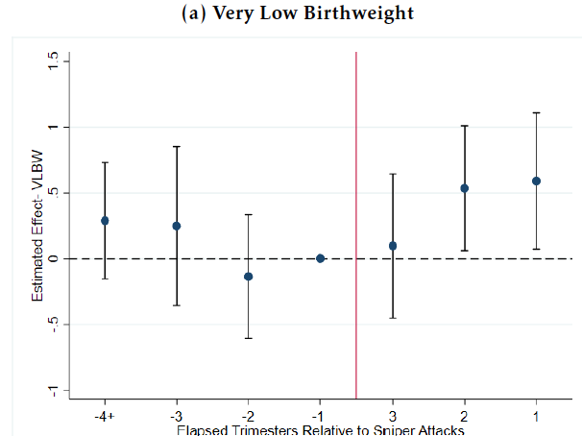
Event studies for Birthweight<1500g, VA
With county-specific trends
Without county-specific trends
Notes:
Figure on the left (Figure 3) has county-specific time trends. Figure on the right (A3) omits them. Each panel shows the coefficient estimates with 95% confidence intervals based on equation (2). “1” , “2”, and “3” denote exposure to Sniper shootings within the first, second, and third trimesters of pregnancy, respectively. q = -1 is the reference category. Standard errors are clustered at the county level. Both outcomes are multiplied by 100 for ease of interpretation.

Slide 28
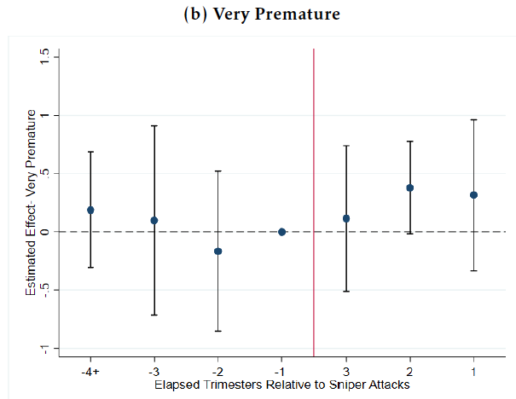
Event studies for < 32 weeks gestation, VA
With county-specific trends
Without county-specific trends
Notes:
Figure on the left (Figure 3) has county-specific time trends. Figure on the right (A3) omits them. Each panel shows the coefficient estimates with 95% confidence intervals based on equation
(2). “1” , “2”, and “3” denote exposure to Sniper shootings within the first, second, and
third trimesters of pregnancy, respectively. q = 1 is the reference category. Standard errors are
clustered at the county level. Both outcomes are multiplied by 100 for ease of interpretation.

Slide 29
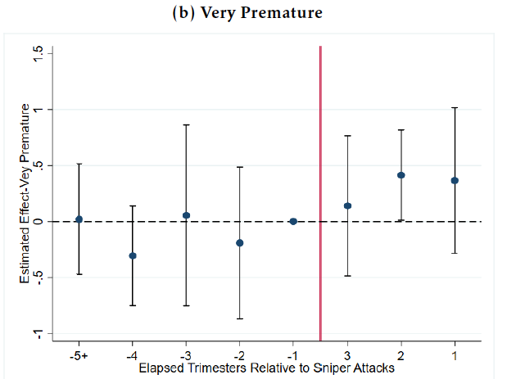
Using a longer pre-period, VA
Notes:
An example with alternative leads and lags. This is Figure A2 – has a longer pre-period. Both have county-specific trends

Slide 30
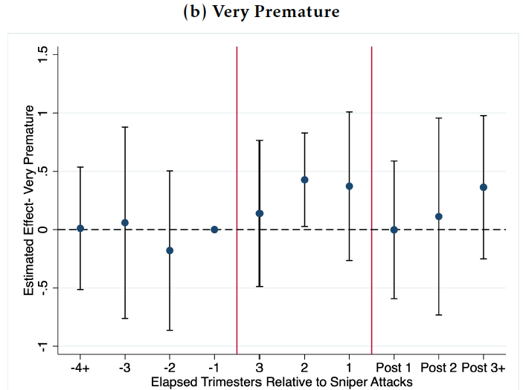
Adding the Post Sniper Shooting Period, VA
Notes:
Notes: Each panel shows the coefficient estimates with 95% confidence intervals based on equation (2). “1” , “2”, and “3” denote exposure to Sniper shootings within the first, second, and
third trimesters of pregnancy, respectively. q = -1 is the reference category. Standard errors are clustered at the county level. Both outcomes are multiplied by 100 for ease of interpretation.

Slide 31
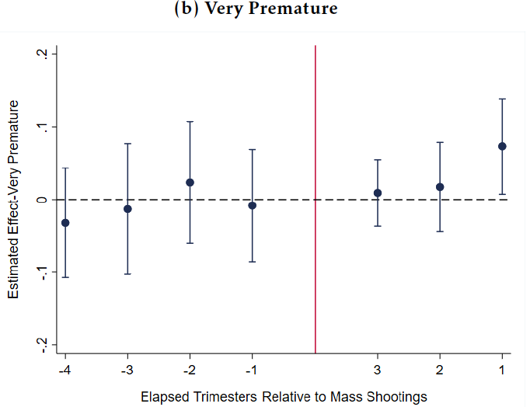
Event Studies, National Data

Slide 32
Difference-in-Difference Models
y_{imdyc} = α + β₁ Close_{imdyc}*Tri¹_{imdyc} + β₂ Close_{imdyc}*Tri²_{imdyc} +
β₃ Close_{imdyc}*Tri³_{imdyc} +μ Close_{imdyc} + η
Close_{imdyc}*Coincide_{imdy}+ φ X_{imdyc} + λ_{dmy} + δ_{c} + δ_{c}t + ε_{imdyc}
- For sniper attacks, treatment is not staggered.
- For mass shootings, treatment is staggered and use the estimator proposed by Borusyak et al. (2023)

Slide 33
Notes:
Note, everything here is multiplied by 100 including the means. So there is a 1.22% prob of VLBW and .00346/.0122 ~25%. Col 2 estimates imply a 35-40% increase.

Slide 35
Including leads
Notes:
Table A2. Interpretation of leads? E.g. -1 means baby born in 3 months prior to the shootings. Each column represents a separate regression based on equation (2). The dependent variable for first (second) column is Very Low Birthweight (Very Premature). The estimates represent interaction terms involving trimester indicators reflecting exposure to Sniper shootings and
the binary indicator variable Close. q = 1 is the reference category. See text for more details about regression specifications and controls. Outcomes
and means of the dependent variables are multiplied by 100 for ease of interpretation.

Slide 36
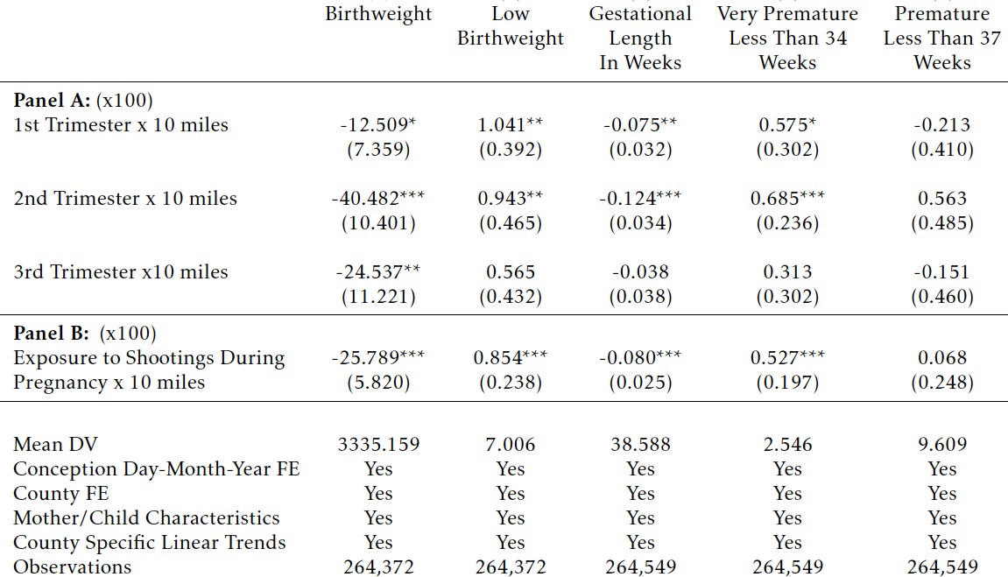

Slide 37
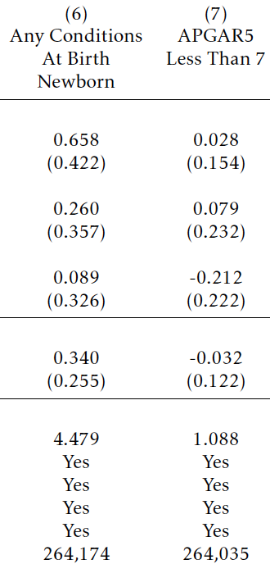

Slide 38
Consider two indices of birth outcomes
The first, a severe birth outcomes index, is comprised of:
- very low birthweight
- very preterm
- any abnormal conditions at birth (e.g., use of assisted ventilation)
- low Apgar score
The second broad birth outcome index, adds all the remaining outcome variables: continuous birthweight in grams, low birthweight, an indicator for preterm based on a 34 weeks of gestation cutoff, an indicator for preterm based on 37 weeks of gestation cutoff, and gestation in weeks.

Slide 39
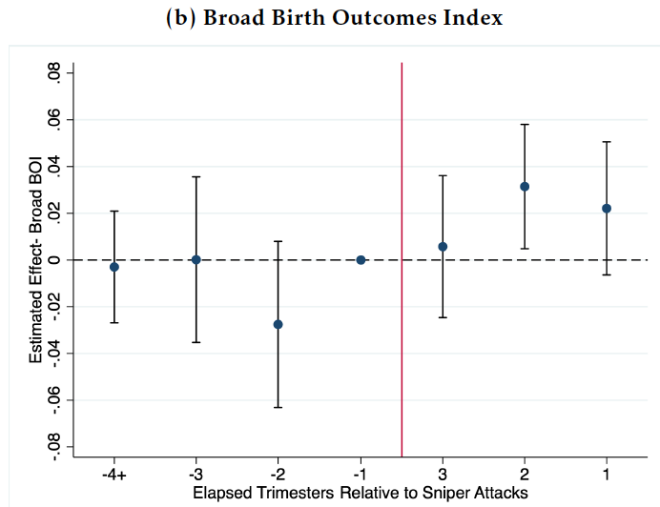
Event studies for indices of birth outcomes, VA
Notes:
Figure on the left is Fig 5. This figure shows event study estimates using the imputation estimator from Borusyak et al.(2022). Each panel shows the coefficient estimates with 95% confidence intervals based on equation (4). “1” , “2”, and “3” denote exposure to mass shootings within the first, second, and third trimesters of pregnancy, respectively. q = 5 is the reference category. Standard errors are
clustered at the county level.

Slide 40
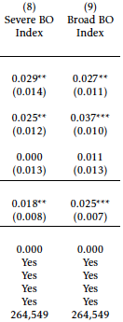
Including a broader range of birth outcomes in an index
Notes:
The first, a severe birth outcomes index, is comprised of the following indicators: very low birthweight, very preterm, any abnormal conditions at birth (e.g., use of assisted ventilation), and low Apgar score. The second is a broad birth outcome index, which adds all the remaining variables in Table 4: continuous birthweight in grams, low birthweight, an indicator for preterm based on a 34 weeks of gestation cutoff, an indicator for preterm based on 37 weeks of gestation cutoff, and gestation in weeks.

Slide 41
Borusyak et al. (2023) estimates for mass shooting effects
Note: Borusyak et al. (2023) estimates for mass shooting effects.
Notes:
This table presents estimates of the effect of exposure to mass shootings between 2006 and 2019 on Very Low Birthweight and Very Premature births. The coefficient estimates are
obtained using imputation estimator from Borusyak et al.(2022). Each column in Panels A and B corresponds a separate regression. The estimates presented in Panel A are trimester
indicators reflecting exposure to mass shootings. Estimates presented in Panel B replace the trimester indicators with an overall measure of exposure to shootings during pregnancy.
See text for more details about regression specifications and controls. Outcomes and means of the dependent variables are multiplied by 100 for ease of interpretation.

Slide 43
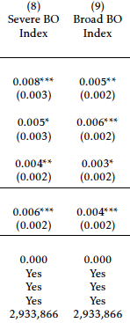
Effect of mass shootings on indices of birth outcomes
Notes:
The point estimates for first trimester translate into effect sizes of 5.7 percent (0.069/1.219) for very low birthweight and 5.2 percent (0.073/1.394) for extreme prematurity.

Slide 44
Do overall effects mask heterogeneous impacts?
Hypothesis: Groups that face more ambient violence will show less of an increase in stress due to gun violence.
- high ambient stress is linked to higher baseline cortisol levels, which in turn is linked to worse infant health outcomes

Slide 45
Different effects by education (sniper attacks)

Slide 46
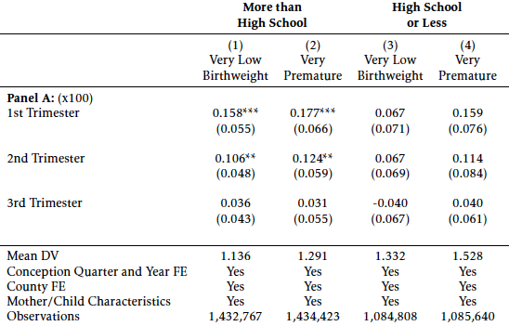
Different effects by education (mass shootings)
Notes:
Table A6. This table presents estimates of the effect of exposure to mass shootings between 2006 and 2019 on various infant health outcomes for different sub-groups of population. The coefficient estimates
are obtained using imputation estimator from Borusyak et al.(2022). Column headings explain the corresponding sub-groups used for analysis. The odd (even) columns employ Very Low Birthweight
(Very Premature) as the dependent variable. The estimates presented are trimester indicators reflecting exposure to mass shootings. See text for more details about regression specifications and controls.
Outcomes and means of the dependent variables are multiplied by 100 for ease of interpretation.

Slide 47
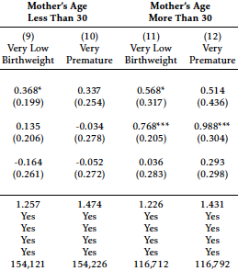
Different effects by maternal age (sniper attacks)

Slide 48
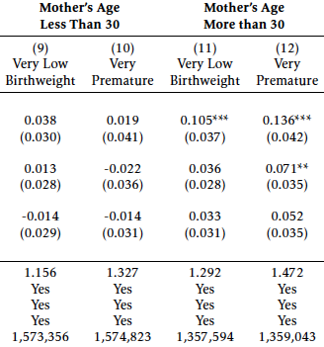
Different effects by maternal age (mass shootings)
Notes:
Table A6

Slide 49
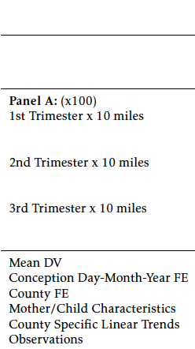
Different effects by race (sniper attacks)
White Infants Black Infants

Slide 50
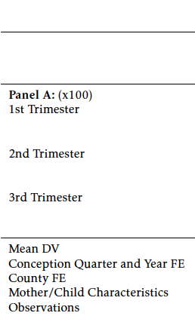
Different effects by race (mass shootings)
White Infants Black Infants

Slide 51
Behavioral responses to sniper attacks?

Slide 52
Behavioral responses to mass shootings

Slide 53
“Placebo” checks
Examine the “effect” of being pregnant in the same Oct. 2-23 period, but in a different year
Divide the calendar into 22 day periods, and treat each one as a potential “sniper attacks” period

Slide 54
Placebo: Oct. 2-23 in alternative years
Notes:
Each column in Panels A and B corresponds to a separate regression. Column headings indicate the years of simulated shootings. The odd
(even) columns employ Very Low Birthweight (Very Premature) as the dependent variable. The estimates presented in Panel A represent interaction
terms involving trimester indicators reflecting exposure to Sniper shootings and the binary indicator variable Close. Estimates presented in
Panel B replace the trimester indicators with an overall measure of exposure to shootings during pregnancy.

Slide 55
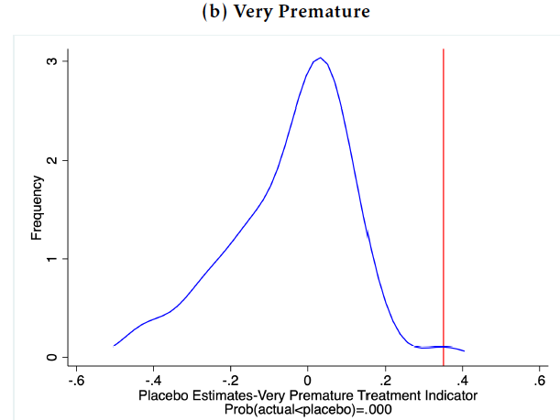
Placebo: Treating each 22-day period as a treated interval
Notes:
Each figure illustrates the distributions of coefficient estimates for single binary indicator for exposure to attacks concerning the simulated shootings generated within 22-day windows
partitioning the sample period. The vertical lines represent the actual estimates, and the x-axis of each plot displays the ratio of placebo estimates exceeding the actual estimates.

Slide 56
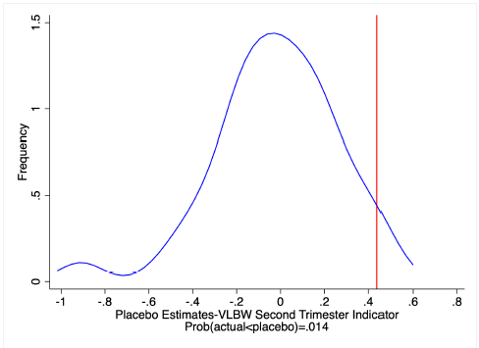
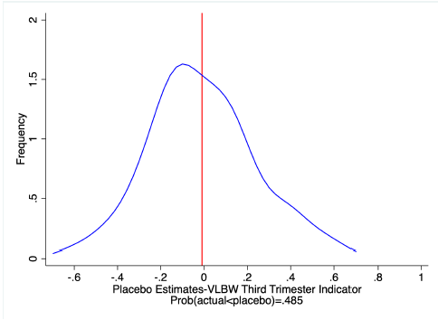
Placebo estimates for VLBW by 1, 2, 3rd trimester

Slide 57
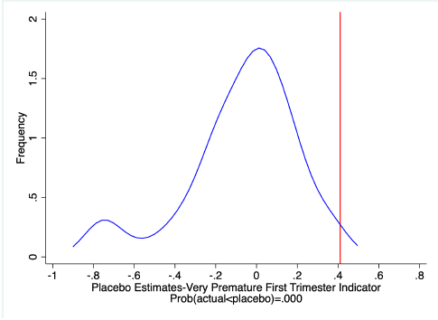
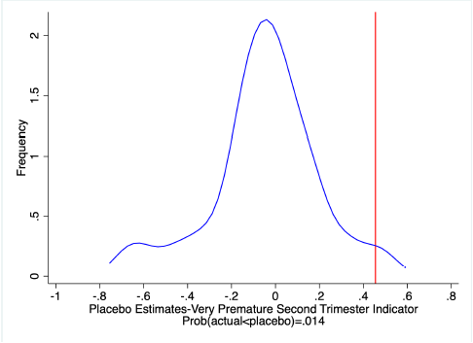
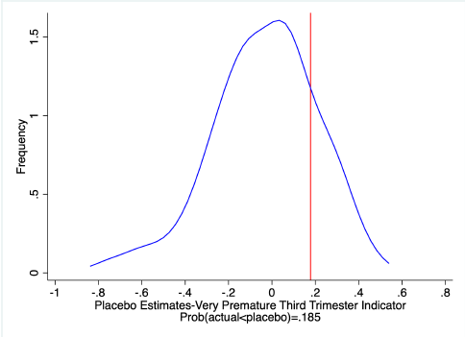
Placebo estimates for very premature by 1, 2, 3rd trimester

Slide 58
Robustness to definition of treatments and controls

Slide 59
Additional Robustness
Including moms < 18
No gestational age restrictions
No marital status or controls for child gender
Adding children conceived after the attacks to the control group
Notes:
This is what is in Table 7

Slide 60
Costs of very low birth weight and increased probability of VLBW due to gun violence
Notes:
A8. This table presents the details of our calculation of the cost of exposure to sniper attacks and mass shootings. We use our estimated effects on the likelihood of very
low birthweight from the binary exposure to sniper attacks (0.316 in Table 3) and mass shootings (0.028 in Table 5) models. Following Currie et al. (2022), we consider increased
costs association with six channels including, higher rate of infant mortality, increased medical costs at and immediately following birth, increased costs associated
with childhood disability, decreases in adult income, increased medical costs associated with adult disability, and reductions in life expectancy. Dollar amounts have been
inflation adjusted to 2023 values using the US consumer price index. To determine the present discounted value of lifetime earnings, we aggregate over the distribution of
earnings data from ages 16 to 64 in the 2017 American Communities Survey, assuming that earnings are discounted using a 3 percent real rate (i.e., a 5 percent discount rate
with 2 percent wage growth) back to age zero.

Slide 61
Calculating total cost as #exposed*costs due to increased probability of VLBW
There were 16,506 Virginians whose pregnancies overlapped with the sniper attacks and who lived within 10 miles of a shooting.
16,506*$940,883= $15.5 billion ($2023) from the increase in very low birthweight attributable to the attacks.
1,168,120 pregnancies coincided with a mass shooting in the same county between 2006 and 2019.
1,168,120*83,369~$7 billion per year, or $97.4 billion over the period.
These results are based on 113 mass shootings and suggest that each mass shooting costs infants affected in utero at least $862 million dollars.

Slide 62
These estimates are lower bounds on the impact of gun violence on infants in utero
Mass shootings make up only 1% of gun deaths
We may be understating the impact of gun violence on less educated/younger/minority people, if they have a high level of ambient stress and thus do not react as much to extreme incidents of gun violence
There may be compensatory responses, e.g. increases in prenatal care
People in the sniper attacks control group (10-50 miles from a shooting) may also have been affected.
In the mass shootings analysis, difficulties measuring the precise location and timing of the events in the national data will also cause us to underestimate their effects.
Hence, although large, the estimates presented in this paper are likely to be conservative.

Slide 63
Conclusions
We provide new evidence about the impact of gun violence on those who are indirectly exposed – in this case infants exposed in utero.
The sniper attacks increased very low birthweight and extreme prematurity by ~25%. Effects are largest in the first 6 months of pregnancy (~35-40%).
Mass shootings are estimated to increase these adverse outcomes by 5-6%.
A conservative estimate is that the beltway sniper attacks cost $15.5 billion while mass shootings cost $7 billion annually through the effects on infants in utero.

Slide 64
Policy responses?
The surest way to reduce the cost would be to stop the violence, but this has proven difficult.
Results imply that people who are expecting should be included in counselling services offered after these incidents.
The U.S. Preventive Services Task Force, recently recommended that all adults 19-64 be screened for anxiety disorders and major depressive disorder (O’Connor et al., 2023).
These recommendations also extend to pregnant and postpartum adults. If they were widely followed, they might help to mitigate the toll.

